Slide 1
Privacy and Confidentiality In Research and the Importance of Both

Slide 2
Grounded in:
Belmont Report
45CFR46.111
21CFR56.111
Both HHS and FDA require IRB review of the provisions for protecting privacy and maintaining confidentiality

Slide 3
Privacy & Confidentiality
Privacy
Confidentiality
About an individual
How an individual controls what information they want to share about themselves
How information, shared by an individual, is treated by a researcher
Privacy in a Research Setting | Confidentiality in a Research Setting
Participant has control over the information they share | Researcher has control over the information collected
Exchange of private information can be in a public setting | Researcher has agreed to protect the information
Privacy is “owned” by the participant | Confidentiality is “owned” by the researcher

Slide 4
POP – QUIZ Which is about Privacy and which is about Confidentiality?
Data access
Respondent providing information to investigator AKA Data collection
Data storage
Data protection

Slide 5
Where will the data be collected? How will the participant control what is shared?
Are there provisions to maintain confidentiality of the data?
How will data be stored
Who will have access to the data?
will the data be de-identified
What should the IRB Consider?

Slide 6
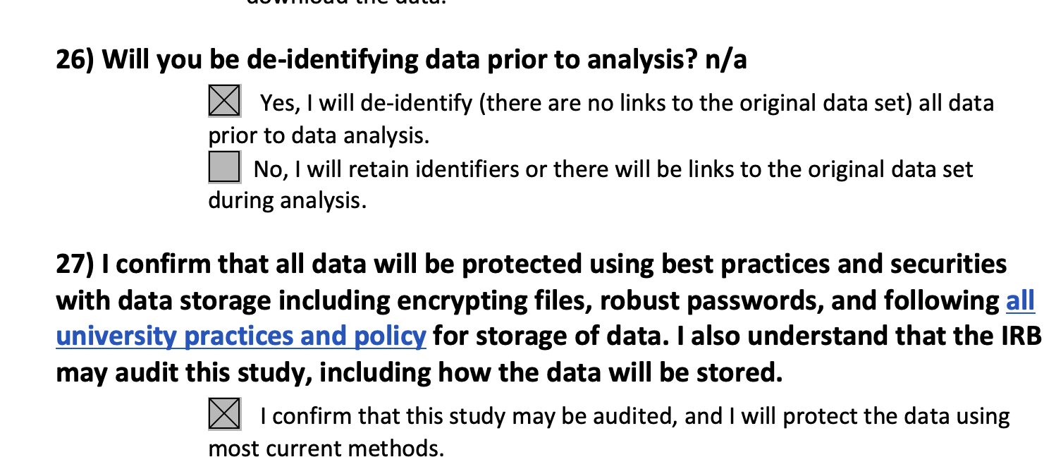
How do we do this in the IRB?
Questions in the protocol that help verify and inform researchers of responsibilities for the protection and storage of information
University and HRPP policies outline the responsibilities of investigators
IRB reviews Informed Consent Forms and Information Sheets to ensure that confidentiality risks are clear
iStar
Protocol

Slide 7
Informed Consent Process
Include a clear description of the information being collected,
State how the information will be used and protected,
State who will have access to the information and what happens to the information after the study ends,
Include mandatory reporting requirements, when applicable.

Slide 8
Young Black Women’s Sexual Health Study
Pilot study to gain an understanding of:
Young Black Women’s (YBW) sexual relationships (risk behaviors, safe sex practices)
Who YBW talk to and who influences them regarding sex and relationships
YBW utilization of social media for partner seeking, sexual health information
Data collection:
Questions focus on HIV risk behaviors and relationship dynamics of young Black couples
Social network information

Slide 9
Young Black Women’s Sexual Health Study
Targeted population are:
Self-identified young Black sexually active women aged 18-24 who live in Los Angeles
Have engaged in vaginal and/or anal sex with the opposite gender no more than 30 days prior to enrollment
Participants are asked to invite at least 3 other YBW in their social network to participate

Slide 10
Young Black Women’s Sexual Health Study
Study location is a professional Black Salon in Inglewood:
Recruitment flyers are posted at the stations
Stylists will inform eligible clients of the study
PI will sit in entrance way and approach clients
Survey and interviews will be conducted in a back room (private space)

Slide 11
Questions for the group:
Based on the information provided:
What are your concerns for:
Protecting participant privacy?
Ensuring confidentiality?
What steps would you require the investigator to take to
Protect participant privacy?
Ensure confidentiality?

Slide 12
Questions?

