Slide 1
IRB Member Education for Social Behavioral Full Board Members Continuing Review
This slide deck includes audio which can be accessed in “presentation mode” or by clicking on the speaker icon

Slide 2
Agenda
Getting started
iSTAR
What to include in your review
Presentation to committee

Slide 3
Getting Started

Slide 4
Guidance for Assignment
When does it need to be completed?
What if I have an emergency and/or cannot complete my review?
Once assigned a study, post the review by noon the day prior to the meeting.
Posting on time gives the IRBA time to follow up on any points of clarification with the study team.
Posting prior to the meeting allows the other members time to review it prior to the meeting.
The staff will try to only assign reviews to you when you indicated you will attend.
You may be assigned a review for a meeting that you are not available to attend.
If you are assigned as a reviewer, you are expected to complete the review unless extenuating circumstances make it impossible (e.g., work or family emergency).
Under those circumstances, you should inform the IRB analyst as soon as possible so the study can be assigned to another reviewer.

Slide 5
Types of Reviews
 | How many reviewers? | How do staff assign reviews? | What should the review focus on?
New Study/Initial | 2 Reviewers, 3rd is optional | Based on the content of the study and reviewer specialty | Full iSTAR application and all materials
Amendment | 1 Reviewer req, 2nd is optional | Based on reviewer specialty and/or previously reviewed the study | Initial review for context and the amendment and any revised materials
Continuing Review | 1 Reviewer req, 2nd is optional | Based on reviewer specialty and/or previously reviewed the study | Previous continuing reviews and any amendments or reportable events within the review period
Reportable Event | 1 Reviewer req, 2nd is optional | The chair will review these in the majority of cases | The reportable event and any related amendments

Slide 6
What do I need to get started?
Time to commit to the review
Log in to iSTAR
Review the iSTAR Continuing Review (CR) application
You may need to review the following for additional context (more in future slides):
Main study application
Past continuing reviews
Any reportable events and amendments submitted during the review period
Keep notes on:
A brief summary of the study (objectives, participants, procedures)
Enrollment status (CR application Section 1, 2, and 5)
Updates/revisions within the review period (reportable events/amendments)
Questions for committee discussion or points of clarification for the study team
Review the IRBA Staff Review for questions/context
Contact the IRBA or the study team if there are additional questions, clarifications, or concerns.

Slide 7
Who is responsible? Roles clarified:
Reviewer
IRBA
Are the supporting materials appropriate? Are they inclusive and understandable?
Is there adequate information to determine the risks to participants?
Is the consent understandable and appropriate for the population?
Is the recruitment inclusive and understandable?
What regulatory determinations might apply?
Do you recommend approval, approval with contingency, deferral, or disapproval?
Completeness of the application
Required CITI trainings are complete
COI is identified and addressed, as applicable
All required supporting materials are provided
Required elements are covered in the Consent
If HIPAA is applicable, it is either waived or the study team will get authorization
Recommend regulatory determinations

Slide 8
iSTAR

Slide 9
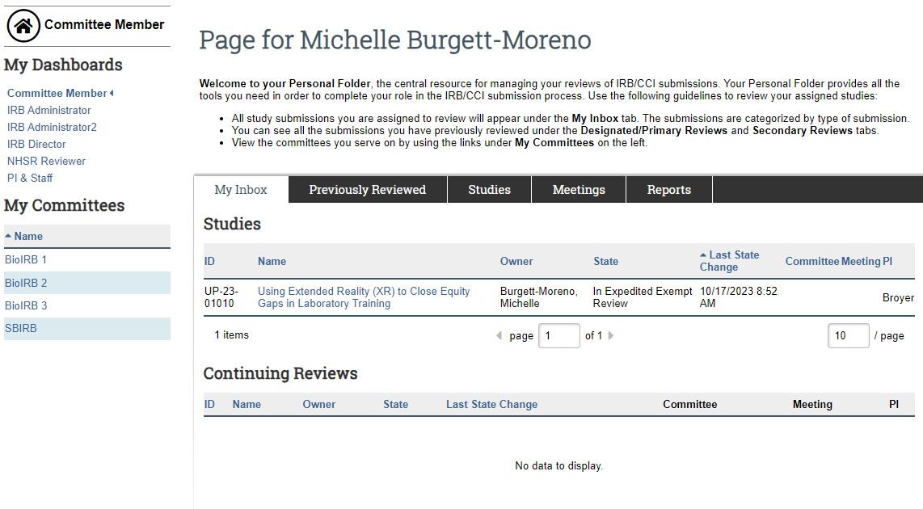
iSTAR - Member inbox – Locate your assignment

Slide 10
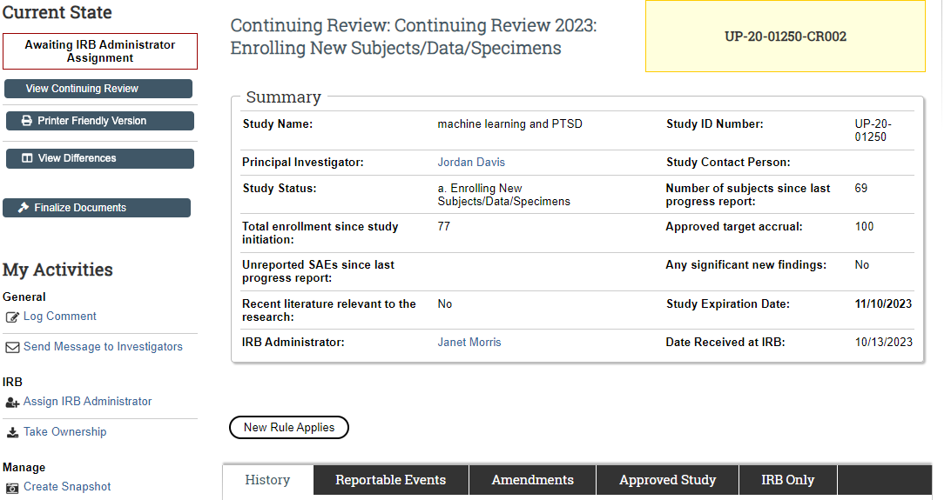
iSTAR – Continuing Review Page

Slide 11
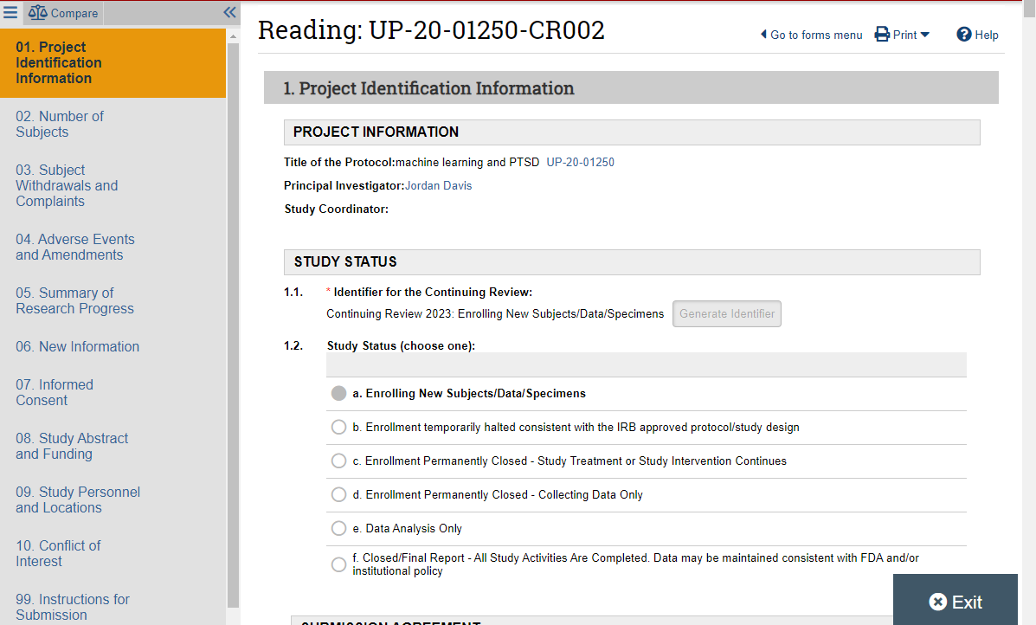
iSTAR – Continuing Review Application

Slide 12
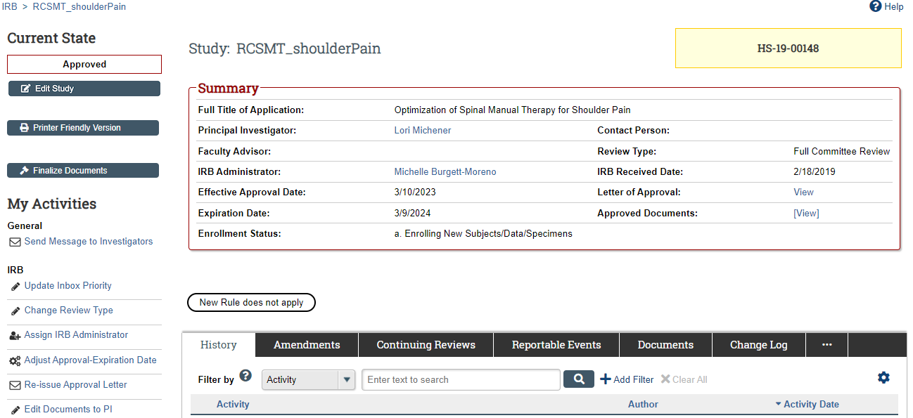
iSTAR – Main Study Page

Slide 13
Under the Reportable Events Tab
Check for any Reportable Events that may not populate in the CR application (if they were submitted in the previous review period but not completed, they won’t show up in the CR)

Slide 14
Under the Amendment Tab
Check for any Amendments that may not populate in the CR application (if they were submitted in the previous review period but not completed, they won’t show up). You can also open the previous AM applications to get a more information about the changes reviewed/approved.

Slide 15
Under the Continuing Review Tab
Take a look at any past CRs to understand the study progress and enrollment. You can also see what previous reportable events or amendments have been captured in previous CRs.

Slide 16
Possible thoughts/questions you may have
“This is the 4th continuing review and they haven’t enrolled.”
Great point! Has the PI addressed why they haven’t enrolled in the CR? If not, you can ask the IRBA or the study team directly via iSTAR or the IRBA assigned.
You can also ask the committee whether this study should stay open?
“There are multiple cohorts and I don’t understand which are recruiting and which are closed.”
Great point! Are they requesting all the consents be renewed or only some of the consents? You can ask the IRBA or the study team directly via iSTAR to clarify how the enrollment numbers match up to their cohorts.
“The enrollment doesn’t seem to match the PI’s reported study progress.”
Great point! You can ask the IRBA or ask the study team directly via iSTAR to clarify. For example, you could ask “how many participants have completed all study activities and how many are ongoing?”

Slide 17
What to include in your review

Slide 18
Review plan for a CR
1. Brief summary of study. Why are they doing the study, who are the participants, and what are they doing.
2. How long has the study been open and what is the current enrollment status?
3. How is enrollment progressing?
If enrolling participants who speak something other than English, how many participants have been enrolled?
4. Summarize any changes that have happened since the last year through amendments.
Change in participants?
Changes to procedures or treatments?

Slide 19
Review plan for a CR
5. Summarize any reportable events over the last year.
What were they? Were they resolved or still ongoing?
Were there any CAPA’s (corrective and preventive action plans)
6. If actively enrolling, did the PI request the consent be renewed?
7. Are there any changes needed to the consent form(s)?
Does the ICF need to be updated to reflect new risks?
Does the study team need to update participant facing materials (ICF/recruitment/surveys) because of non-English speaking participants?

Slide 20
Presentation to committee

Slide 21
Full Board Meeting - The players
The Chair Introduces each agenda item and maintains the flow of the meeting
Primary Reviewer Provides overall summary of the study and study progress
IRBA Conducts initial review to ensure completeness, guides regulatory determinations

Slide 22
Presenting your review to the board
Summarize the study: Why, who, what, and where.
1
Summarize the enrollment: What is the status? How is enrollment progressing?
2
What changes have been made since the last review period? Summarize amendments and reportable events.
3
Did they request the consent be renewed? Are any changes needed?
4
What are the regulatory determinations? Do you recommend approval?
5

Slide 23
Thank you

