Slide 1
IRB Member Education for Social Behavioral Full Board Members Initial Review
This slide deck includes audio which can be accessed in “presentation mode” or by clicking on the speaker icon

Slide 2
Agenda
Getting started
iSTAR
What to include in your review
Presentation to committee

Slide 3
Getting Started

Slide 4
Guidance for Assignment
When does it need to be completed?
What if I have an emergency and/or cannot complete my review?
Once assigned a study, post the review by noon the day prior to the meeting.
Posting on time gives the IRBA time to follow up on any points of clarification with the study team.
Posting prior to the meeting allows the other members time to review it prior to the meeting.
The staff will try to only assign reviews to you when you indicated you will attend.
You may be assigned a review for a meeting that you are not available to attend.
If you are assigned as a reviewer, you are expected to complete the review unless extenuating circumstances make it impossible (e.g., work or family emergency).
Under those circumstances, you should inform the IRB analyst as soon as possible so the study can be assigned to another reviewer.

Slide 5
Types of Reviews
 | How many reviewers? | How do the staff assign reviews? | What should the review focus on?
New Study/Initial | 2 Reviewers, 3rd is optional | Based on the content of the study and reviewer specialty | Full iSTAR application and all materials
Amendment | 1 Reviewer req, 2nd is optional | Based on reviewer specialty and/or previously reviewed the study | Initial review for context and the amendment and any revised materials
Continuing Review | 1 Reviewer req, 2nd is optional | Based on reviewer specialty and/or previously reviewed the study | Previous continuing reviews and any amendments or reportable events within the review period
Reportable Event | 1 Reviewer req, 2nd is optional | The chair will review these in the majority of cases | The reportable event and any related amendments

Slide 6
What do I need to get started?
Time to commit to the review
Log in to iSTAR
Review the iSTAR application and supplemental materials such as the protocol, consent, recruitment, etc.
Keep notes on:
Briefly summarize the study for the other members.
Any risks you identify to subjects
Questions or points of clarification for the study team
Review the IRBA Staff Review for questions/context
Contact the IRBA or the study team if there are additional questions, clarifications, or concerns.

Slide 7
Who is responsible? Roles clarified:
Reviewer
IRBA
Are the supporting materials appropriate? Are they inclusive and understandable?
Is there adequate information to determine the risks to participants?
Is the consent understandable and appropriate for the population?
Is the recruitment inclusive and understandable?
What regulatory determinations might apply?
Do you recommend approval, approval with contingency, deferral, or disapproval?
Completeness of the application
Required CITI trainings are complete
COI is identified and addressed, as applicable
All required supporting materials are provided
Required elements are covered in the Consent
If HIPAA is applicable, it is either waived or the study team will get authorization
Recommend regulatory determinations

Slide 8
iSTAR

Slide 9
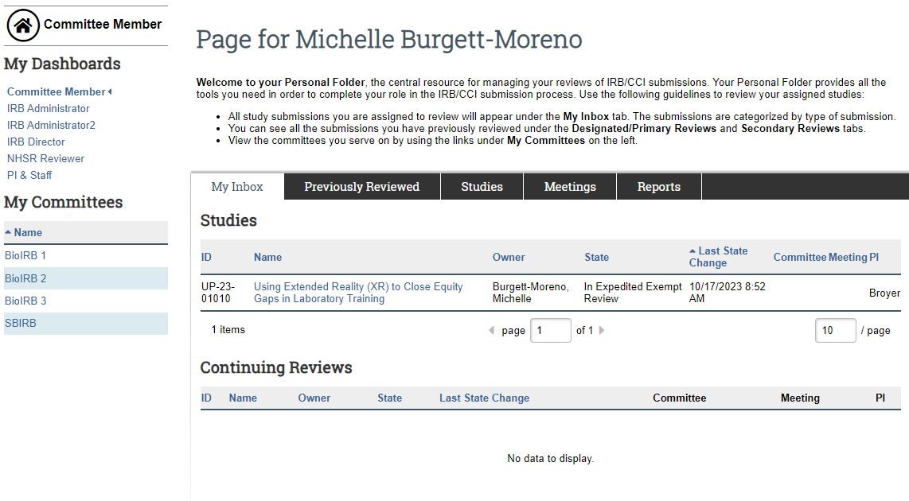
iSTAR - Member inbox – Locate your assignment

Slide 10
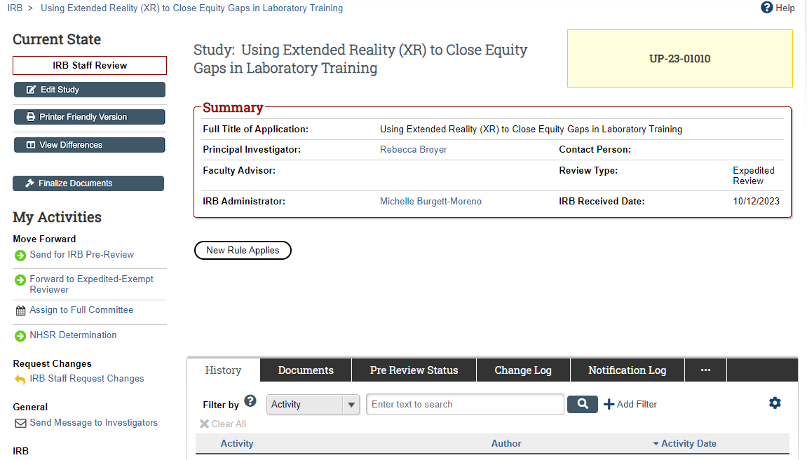
iSTAR – Main Study Page

Slide 11
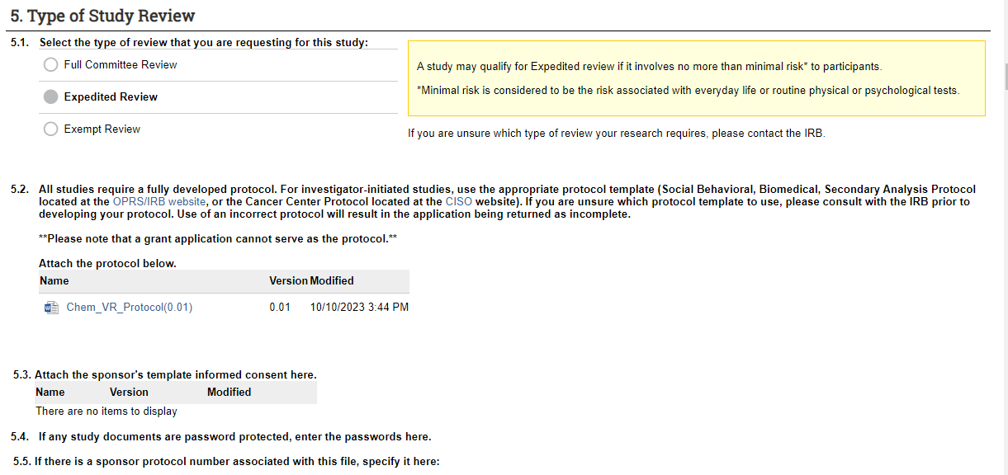
iSTAR - Study Application – Protocol

Slide 12
Social Behavioral Protocol Template

Slide 13
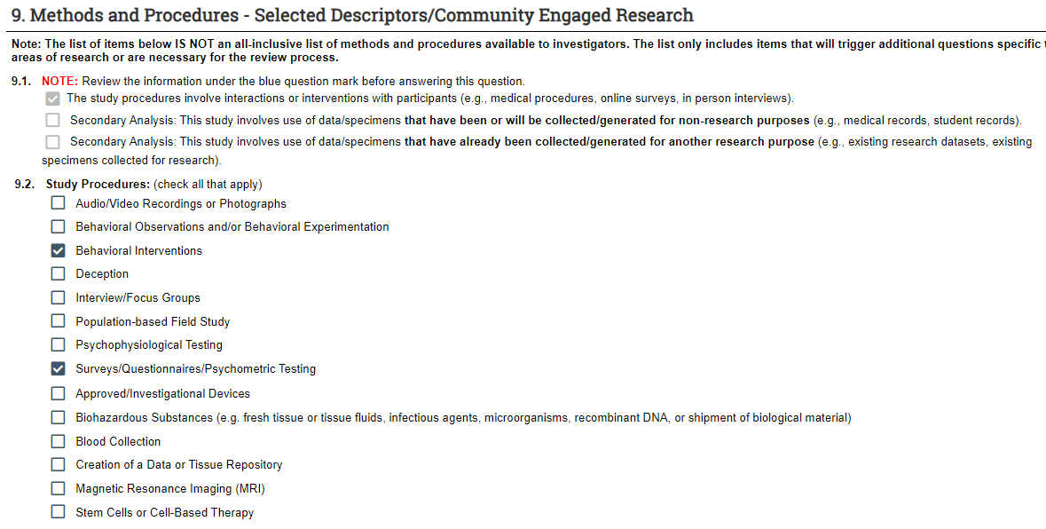
iSTAR - Study Application – Methods/Materials

Slide 14
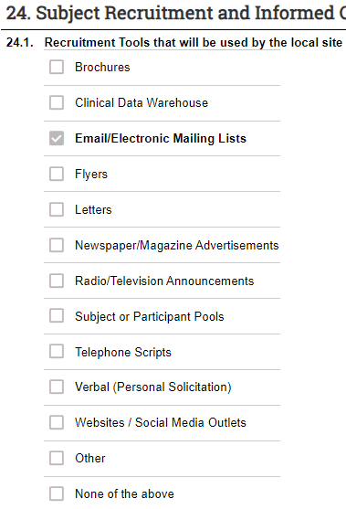
iSTAR - Study Application – Recruitment

Slide 15
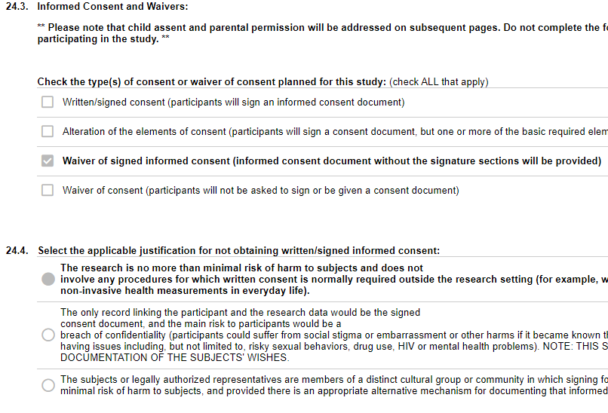
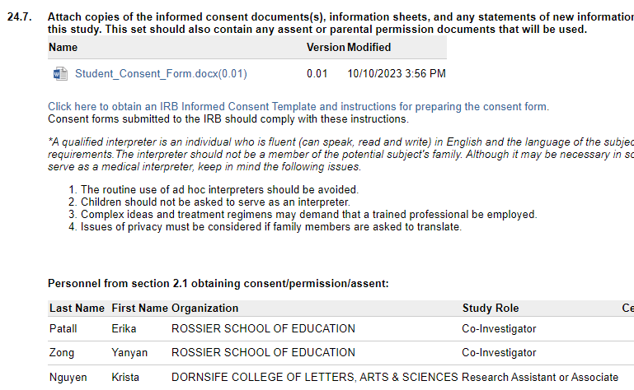
iSTAR - Study Application - Consent

Slide 16
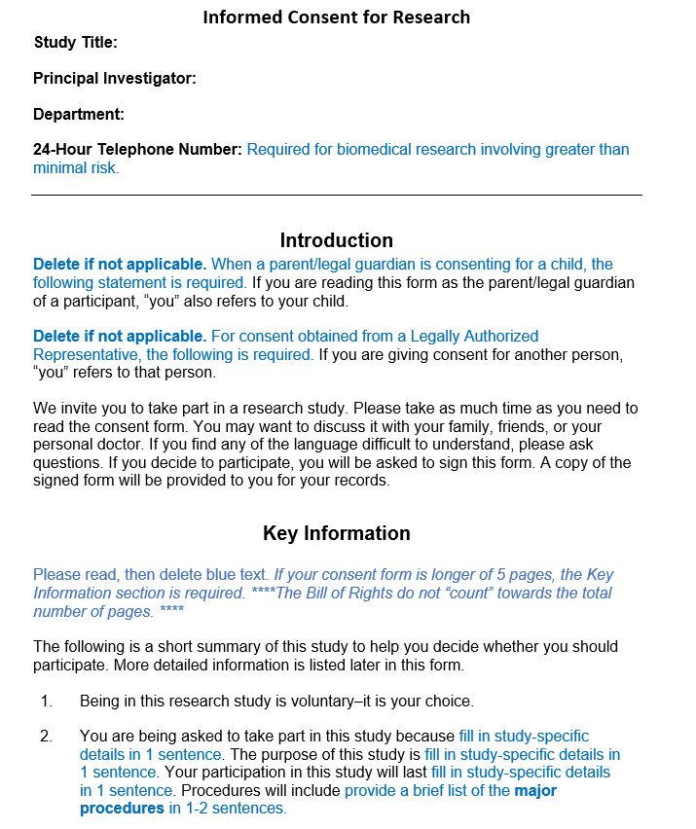
Main Consent Template

Slide 17
What to include in your review

Slide 18
Review plan for a new study
What is the objective of the study?
Is the study design appropriate to learn about the objectives?
What are the outcome measures and endpoints?
Consider any additional applicable regulations: FDA Device/Drug, Pregnant Women/neonates, Prisoners, Minors

Slide 19
Review plan for a new study
Who are the participants?
How is the study team finding participants (recruitment)?
What are the participants doing?
Where will data be collected?
Are the risks reflected in participant facing materials (Informed Consent, etc)?

Slide 20
Considerations for your review
Are there ways to alleviate the risk? Have they been implemented?
Are the risks reasonable in relation to the benefits?
Are the inclusion criteria and recruitment methods equitable?
Is there deception/coercion in the study? If so, does it affect the risk determination?
Are there appropriate measures to monitor the data/safety of the study?
Are there appropriate measures in place to protect the privacy and maintain confidentiality of data?
Are there adequate safeguards for any special populations?
How do the above factors make a difference in risk?

Slide 21
Presentation to committee

Slide 22
Full Board Meeting - The players
The Chair Introduces each agenda item and maintains the flow of the meeting
Primary Reviewer Provides overall summary of the study, risk assessment, determinations
Secondary Reviewer Identifies areas of risk, determinations, and readability of materials
IRBA Conducts initial review to ensure completeness, guides regulatory determinations

Slide 23
Presenting your review to the board
Summarize the study: Why, who, what, and where.
1
What are the risks? Have they been minimized? Are they in relation to benefit? Is the benefit direct or indirect?
2
Is the recruitment appropriate? Is it equitable? Are there any conflicts or potential for influence/coercion?
3
Is the consent clear and focused? Is it understandable to the participant population?
4
What are the regulatory determinations? Do you recommend approval?
5

Slide 24
Thank you

