Slide 1
IRB Member Education for Social Behavioral Full Board Members Amendment
This slide deck includes audio which can be accessed in “presentation mode” or by clicking on the speaker icon

Slide 2
Agenda
Getting started
iSTAR
What to include in your review
Presentation to committee

Slide 3
Getting Started

Slide 4
Guidance for Assignment
When does it need to be completed?
What if I have an emergency and/or cannot complete my review?
Once assigned a study, post the review by noon the day prior to the meeting.
Posting on time gives the IRBA time to follow up on any points of clarification with the study team.
Posting prior to the meeting allows the other members time to review it prior to the meeting.
The staff will try to only assign reviews to you when you indicated you will attend.
You may be assigned a review for a meeting that you are not available to attend.
If you are assigned as a reviewer, you are expected to complete the review unless extenuating circumstances make it impossible (e.g., work or family emergency).
Under those circumstances, you should inform the IRB analyst as soon as possible so the study can be assigned to another reviewer.

Slide 5
Types of Reviews
 | How many reviewers? | How do staff assign reviews? | What should the review focus on?
New Study/Initial | 2 Reviewers, 3rd is optional | Based on the content of the study and reviewer specialty | Full iSTAR application and all materials
Amendment | 1 Reviewer req, 2nd is optional | Based on reviewer specialty and/or previously reviewed the study | Initial review for context and the amendment and any revised materials
Continuing Review | 1 Reviewer req, 2nd is optional | Based on reviewer specialty and/or previously reviewed the study | Previous continuing reviews and any amendments or reportable events within the review period
Reportable Event | 1 Reviewer req, 2nd is optional | The chair will review these in the majority of cases | The reportable event and any related amendments

Slide 6
What do I need to get started?
Time to commit to the review (approximately 45 minutes-1 hour)
Log in to iSTAR
Review the iSTAR Amendment application and supplemental materials such as the protocol, consent, recruitment, etc.
You may need to review the following for additional context (more in future slides):
Main study application (what was initially approved)
Previous amendments (what other changes were made before now)
Keep notes on:
A brief summary of the study as it was previously approved (objectives, participants, procedures)
A brief summary of the changes (participants, procedures, recruitment, consent, etc.)
Questions for committee discussion or points of clarification for the study team
Review the IRBA Staff Review for questions/context
Contact the IRBA or the study team if there are additional questions, clarifications, or concerns.

Slide 7
Who is responsible? Roles clarified:
Reviewer
IRBA
Are the supporting materials appropriate? Are they inclusive and understandable?
Is there adequate information to determine the risks to participants?
Is the consent understandable and appropriate for the population?
Is the recruitment inclusive and understandable?
What regulatory determinations might apply?
Do you recommend approval, approval with contingency, deferral, or disapproval?
Completeness of the application
Required CITI trainings are complete
COI is identified and addressed, as applicable
All required supporting materials are provided
Required elements are covered in the Consent
If HIPAA is applicable, it is either waived or the study team will get authorization
Recommend regulatory determinations

Slide 8
iSTAR

Slide 9
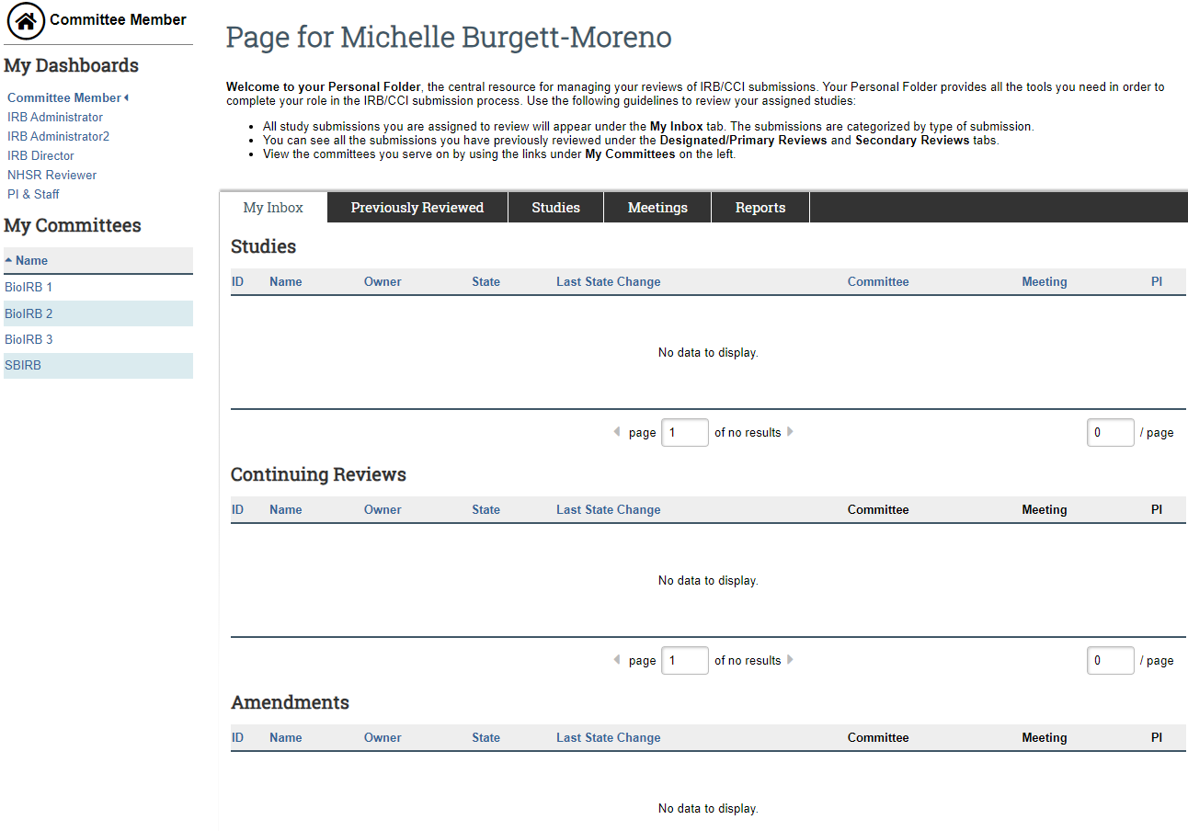
iSTAR - Member inbox – Locate your assignment

Slide 10
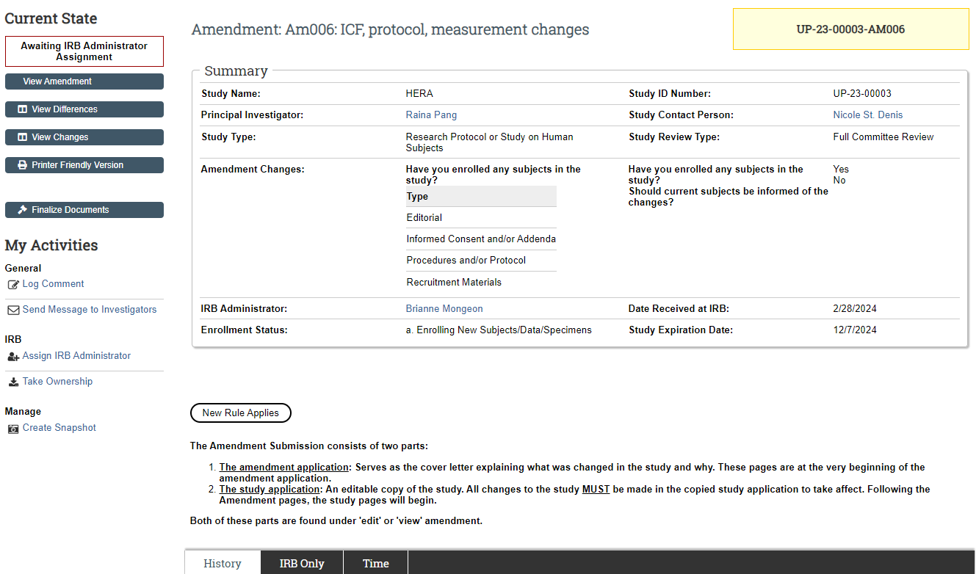
iSTAR – Amendment Page

Slide 11
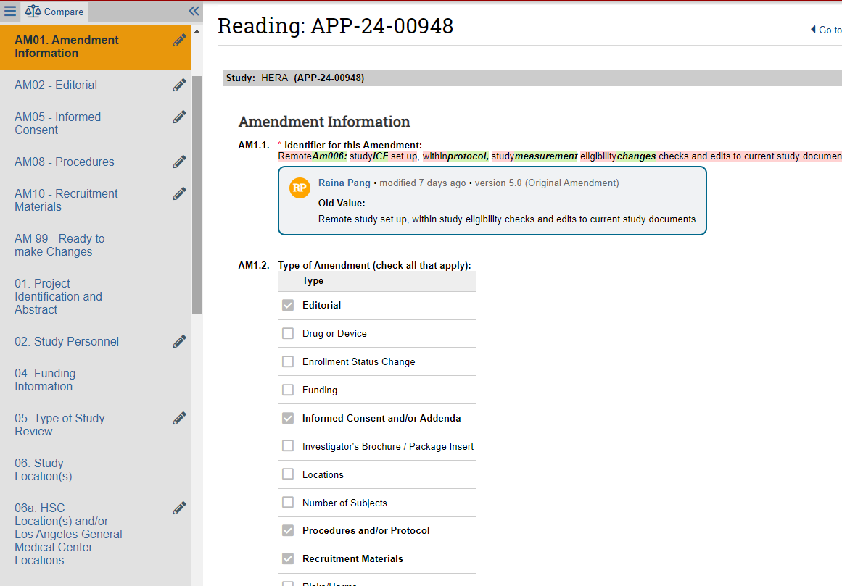
iSTAR – Amendment – View Differences

Slide 12
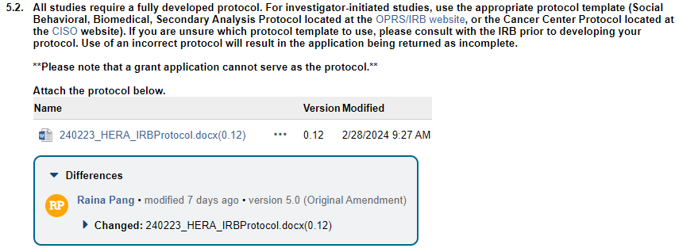
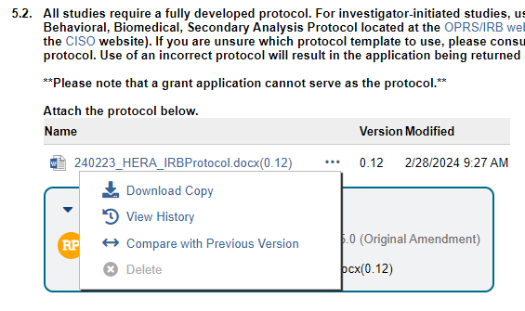
iSTAR – Amendment – View Differences

Slide 13
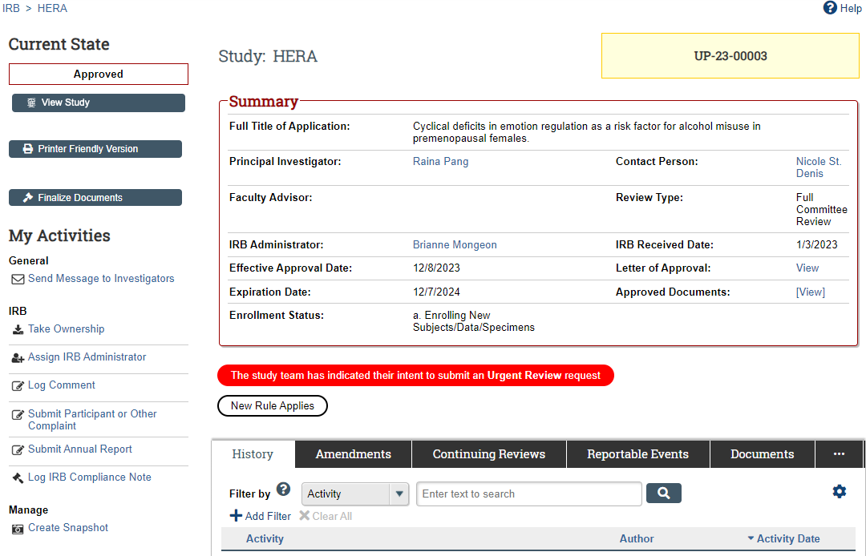
iSTAR – Main Study Page

Slide 14
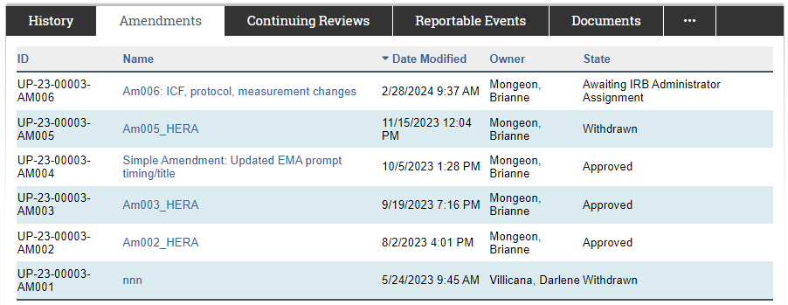
Under the Amendment Tab
Check for any previous Amendments to get a more information about previous revisions to the main study since the initial approval. Some may have been minor changes approved by Expedited Review and others may have been withdrawn.

Slide 15
Under the Reportable Events Tab
When considering if the changes may impact risks/benefits, consider if there have been any reportable events submitted.

Slide 16
What to include in your review

Slide 17
Drafting your review (about 10-15 minutes)
1. Brief summary of study. Why are they doing the study, who are the participants, and what are they doing.
2. Summarize what is changing in the current amendment.
Change in participant inclusion/exclusion criteria?
Changes to procedures or treatments?
3. Do the proposed changes affect the risks/benefits?
Does the study still meet the approval criteria?
4. Are there any changes needed to the consent form(s)?
Does the ICF need to be updated to reflect new risks? Should previously enrolled participants be re-consented?
Does the study team need to update participant facing materials (ICF/recruitment/surveys) because of non-English speaking participants?

Slide 18
Presentation to committee

Slide 19
Full Board Meeting - The players
The Chair Introduces each agenda item and maintains the flow of the meeting
Primary Reviewer Provides overall summary of the study and proposed changes, risk assessment, and review recommendation
IRBA Conducts initial review to ensure completeness, guides regulatory determinations

Slide 20
Presenting your review to the board
Summarize the study: Why, who, what, and where.
1
Summarize the proposed changes.
2
Describe whether the risks/benefits have changed.
3
Are changes needed to the consent?
4
What are the regulatory determinations? Do you recommend approval?
5

Slide 21
Thank you

