Slide 1
IRB Actions
May 2024

Slide 2
Order of operations toward a committee action
The Primary Reviewer presents their summary/concerns.
The Secondary Reviewer presents their summary/concerns (if applicable)
The committee discusses the study following the presentation of the primary and secondary reviewers’ evaluation and comments.
The Primary Reviewer includes a recommendation for a motion in their written review and shares it with the board.
Following the committee discussion, a final motion is made…
45 CFR 46. 111 Criteria for IRB approval of research (DHHS)
21 CFR 56.111 Criteria for IRB approval of research (FDA)

Slide 3
Possible Committee Actions
Approve
Approve with Contingencies, Designated Reviewer
Approve with Contingencies, Staff Verifiable
Defer
Disapprove
45 CFR 46. 111 Criteria for IRB approval of research (DHHS)
21 CFR 56.111 Criteria for IRB approval of research (FDA)

Slide 4
Committee Actions
Approve
The study as written meets all criteria for approval with no further changes
45 CFR 46. 111 Criteria for IRB approval of research (DHHS)
21 CFR 56.111 Criteria for IRB approval of research (FDA)
Committee Actions USC HRPP Policies, Chapter 7.8

Slide 5
Committee Actions
Approve with Contingencies, Designated Reviewer
The board finds that the application is “approvable” with modifications, clarifications, and/or verifications, examples:
confirmation of specific assumptions or understandings on the part of the IRB regarding how the research will be conducted;
submission of additional documentation;
precise language changes to protocol or informed consent documents; or
substantive changes to protocol or informed consent documents along with clearly stated parameters that the changes must satisfy.
This may be a chair, committee member, or IRB analyst with appropriate experience or expertise
Committee Actions USC HRPP Policies, Chapter 7.8

Slide 6
Committee Actions
Approve with Contingencies, Staff Verifiable
If changes proposed are administrative/editorial in nature, NOT part of the approval criteria then no additional IRB review is needed, and the changes can be reviewed as part of the verification process.
The contingency cannot be tied to a judgement or justification.
Examples: confirmation of ancillary approvals, site permission, HRPO approval, check a box, very precise changes to a document, CTO.
This is less about “who” reviews as it is about the nature of the contingency
Committee Actions USC HRPP Policies, Chapter 7.8

Slide 7
Committee Actions
Defer
The board has concerns about the study or significant information or modifications are needed that are directly relevant to the criteria for approval.
Examples:
Questions about the risks, research design/methodology, statistical analysis, data safety monitoring plan, provisions for protecting participant’s safety and privacy, and informed consent documents.
Committee Actions USC HRPP Policies, Chapter 7.8

Slide 8
Committee Actions
Disapprove
The protocol describes research activities that may pose significant concerns for human participant safety with minimal prospect of benefit
The risk to benefit ratio is deemed unfavorable
Committee Actions USC HRPP Policies, Chapter 7.8

Slide 9
Is it a designated reviewer contingency, staff verifiable contingency, or deferral?
Designated Reviewer
Staff Verifiable
Defer
Clarify the time points at which participants will be evaluated to determine imminent risk in the suicide plan.
Confirm that the IP address will not be recorded.
Please revise the exclusion criteria to specify what score on the Montreal Cognitive Assessment (MoCA) will result in a participant being excluded.
Please upload the HRPO review document once obtained.
Please revise the exclusion criteria to explain if and how you will exclude those with diminished capacity.
Approve with Contingencies, Designated Reviewer
Approve with Contingencies, Staff Verifiable
Approve with Contingencies, Designated Reviewer
Approve with Contingencies, Staff Verifiable
Approve
Approve w/ contingencies, designated reviewer
Approve w/contingencies, staff verifiable
Defer
Disapprove
Defer

Slide 10
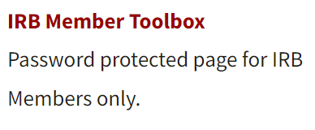
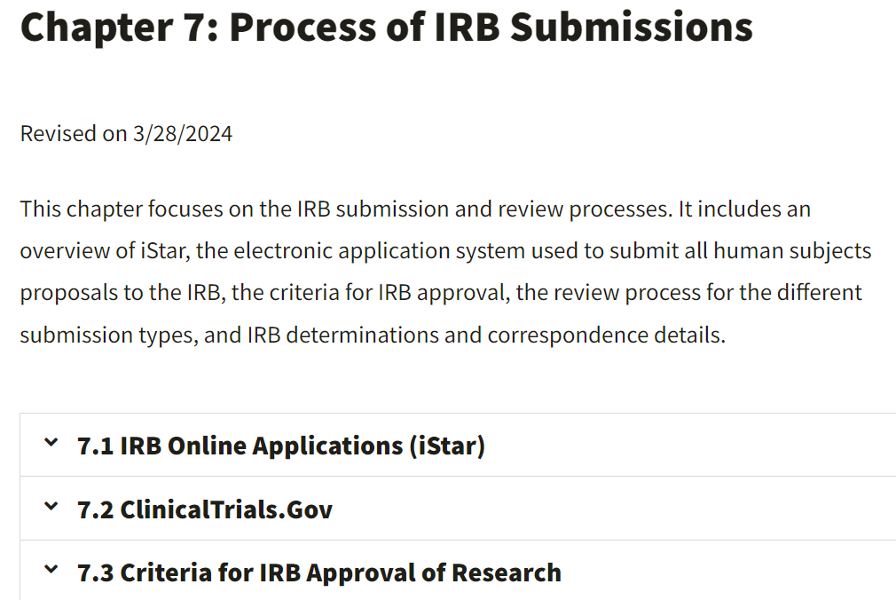
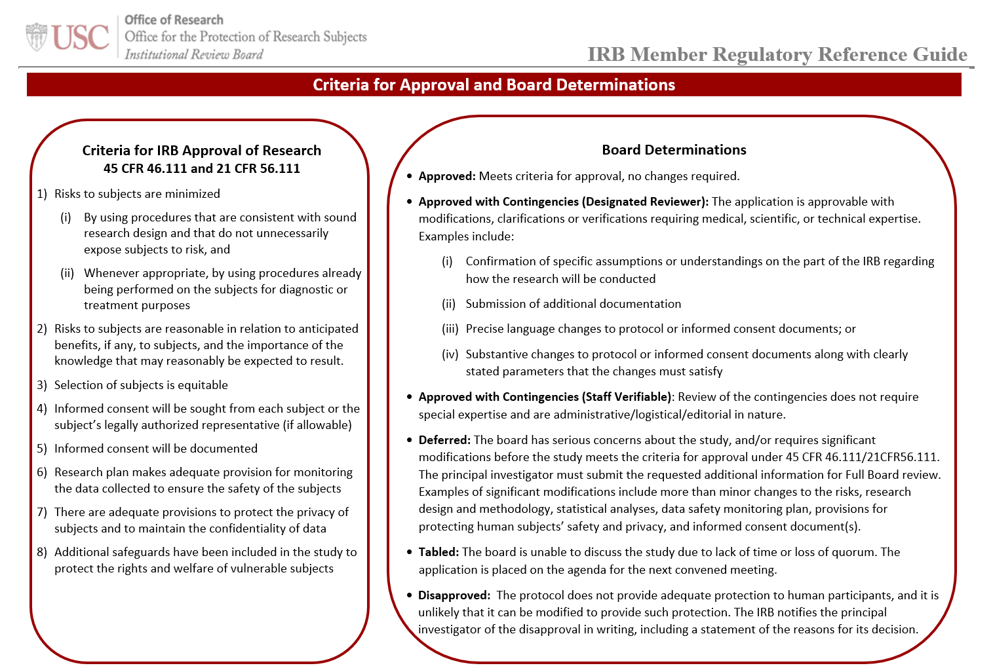
Where Can I Find More Information?
USC HRPP Website
Policies
IRB Member Toolbox
IRB Member Regulatory Reference Guide (attached with meeting agenda)
Code of Federal Regulations
45 CFR 46.111
21 CFR 56.111
IRB Member Handbook (Amdur/Bankert)
Committee Actions USC HRPP Policies, Chapter 7.8

Slide 11
IRB Review Actions
Thank You!
May 2024

